Slide 1
Intrusion Detection System

Slide 2
01
Anomaly Detection Using Gaussian
Mixture Probability Model to Implement
Intrusion Detection System
Introduction
03
Study on Decision Tree and KNN Algorithm for
Intrusion Detection System
02
04
Déploiement
Plan

Slide 3
01
Introduction

Slide 4
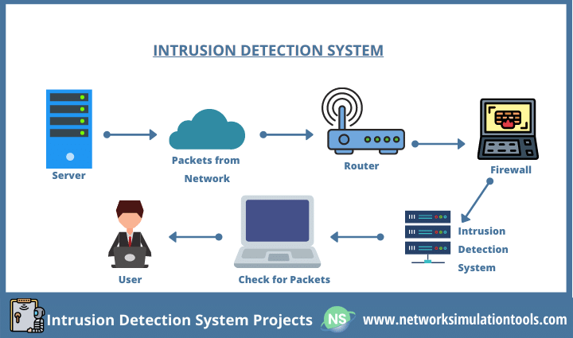
IDS : Intrusion Detection System
An Intrusion Detection System (IDS) is a security technology that monitors computer networks or systems for signs of unauthorized or malicious activity and alerts administrators or takes action to protect against potential threats.
Initially, the features extracted from data packets then it forwarded to our proposed IDS.
Then, proposed
IDS compute the distance between the extracted features and trained model.
Here, trained model consists of big datasets with distributed storage environment to improve the performance of Intrusion Detection system.
Thus, the outlier value is greater than the specified threshold then it generates the false alarm.
Notes:
Initially, the features extracted from data packets then it forwarded to our proposed IDS. Then, proposed
IDS compute the distance between the extracted features and trained model. Here, trained model consists of big
datasets with distributed storage environment to improve the performance of Intrusion Detection system. Thus, the
outlier value is greater than the specified threshold then it generates the false alarm
siwar

Slide 5

How does an IDS work?
4- detects something that matches one of these rules or patterns, it sends an alert to the system administrator.
1- monitors the traffic on a computer network to detect any suspicious activity.
3- compares the network activity to a set of predefined rules and patterns to identify any activity that might indicate an attack or intrusion.
2- It analyzes the data flowing through the network to look for patterns and signs of abnormal behavior.

Slide 6
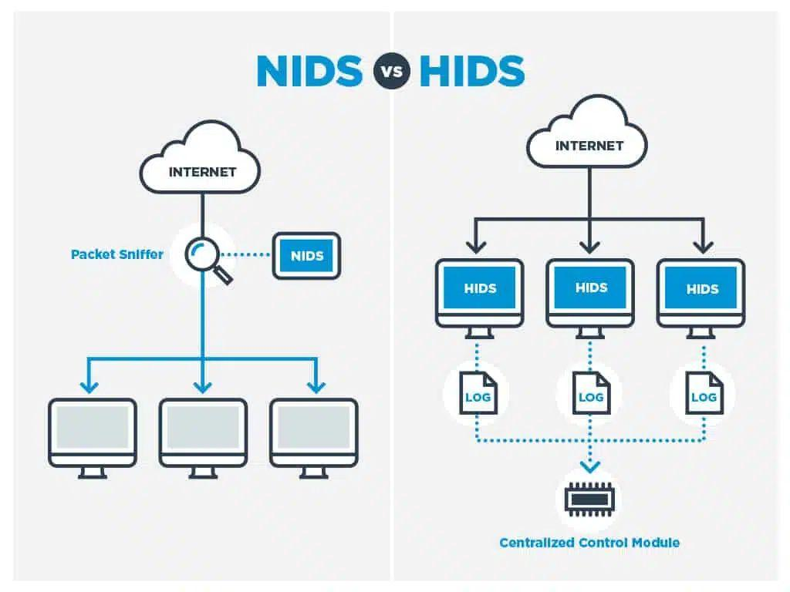
IDS can be categorized into two main types:

Slide 7
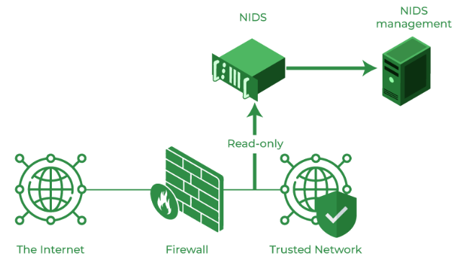
NIDS
Network intrusion detection systems (NIDS) are set up at a planned point within the network to examine traffic from all devices on the network. It performs an observation of passing traffic on the entire subnet and matches the traffic that is passed on the subnets to the collection of known attacks. Once an attack is identified or abnormal behavior is observed, the alert can be sent to the administrator. An example of a NIDS is installing it on the subnet where firewalls are located in order to see if someone is trying to crack the firewall.

Slide 8
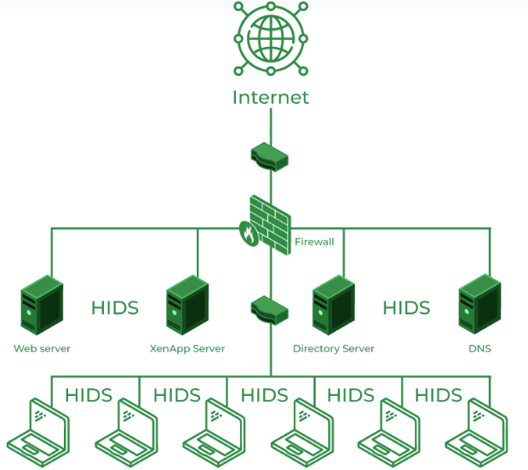
HIDS
HIDS operates on individual hosts or endpoints within a network. It monitors system logs, file integrity, registry changes, and other host-specific events to detect signs of intrusion or compromise. HIDS is typically implemented using software agents installed on individual hosts or centrally managed through an administration console.
Notes:
Host-based IDS (HIDS): HIDS operates on individual hosts or endpoints within a network. It monitors system logs, file integrity, registry changes, and other host-specific events to detect signs of intrusion or compromise. HIDS is typically implemented using software agents installed on individual hosts or centrally managed through an administration console.

Slide 9
Business Understanding
Signature-based Method: Efficient for known threats with low false positives but struggles with new, unknown threats and requires regular signature updates.
Anomaly-based Method: Excels in detecting unknown threats through machine learning, with potential initial false positives, and demands more computational resources for dynamic model training.

Slide 10
Business Understanding
Problem: Inability to Detect Unknown Malware
Problem: Potential False Positives
Objective: Strengthen Anomaly Detection for Unknown Threats
Objective: Acknowledge the emergence of the anomaly-based method to address the limitation of detecting unknown malware.
Objective: Invest in the development and refinement of anomaly-based systems, leveraging machine learning to enhance the detection capability for novel threats.
Objective: Minimize False Positives in Anomaly Detection
Objective: Recognize the challenge of false positives in anomaly-based detection and the potential impact on normal operations.
Objective: Fine-tune machine learning algorithms and implement adaptive learning mechanisms to reduce false positives, ensuring a more accurate identification of suspicious activities.

Slide 11
Business Understanding
Comprehensive Threat Detection
Efficiency in Resource Utilization
Objective: Integrate both signature-based and anomaly-based methods into a hybrid system for comprehensive threat detection.
Objective: Establish a balance that leverages the strengths of each method to cover a broad spectrum of known and unknown threats.
Objective: Optimize resource allocation by combining the efficiency of signature-based detection for known threats with the adaptability of anomaly-based methods for unknown threats.
Continuous Improvement:
Objective: Foster a culture of continuous improvement by investing in research and development, staying abreast of technological advancements, and adapting detection methods to evolving cyber threats.

Slide 12
Business Understanding
Feature Description:
1.Duration: Duration of connection (in seconds)
Understanding the time duration of connections is crucial for analyzing network activity and identifying potential anomalies. Longer durations may indicate suspicious behavior.
2.Protocol_type: Type of protocol
Knowing the protocol type used in network connections is essential for recognizing normal and abnormal patterns of communication. Different protocols may have different security implications.
3.Service: Network type
Identifying the type of network service provides insights into the nature of connections. Understanding various network services is vital for distinguishing between legitimate and potentially malicious activities.
4.Flag: Flag status
Flag status in network communication helps in understanding the status of connections, such as whether they are normal or involve potential security threats.

Slide 13
5.Src_bytes: Number of bytes transferred from source to destination
Monitoring the volume of data transferred from source to destination aids in detecting unusual data flows, which could indicate a security breach or suspicious activity.
6.Dst_bytes: Number of bytes transferred from destination to source
Similar to Src_bytes, tracking the volume of data transferred from destination to source provides additional context for assessing network behavior and potential security issues.
7.Land: If the connection is to the same host, land=1; else, 0
Identifying whether connections are within the same host is important for detecting certain types of attacks, such as those attempting to exploit vulnerabilities on the same system.
8.Wrong_fragment: Number of wrong fragments
Monitoring wrong fragments in network communication helps in identifying potential fragmentation attacks, which can be indicative of malicious intent.
9.Urgent: Number of urgent packets
Tracking urgent packets provides information about the priority of network traffic, which can be useful in identifying abnormal or potentially malicious activities.

Slide 14
10.Hot: Number of "hot" indicators
Business Understanding: The presence of "hot" indicators can be a sign of suspicious or abnormal activity. Understanding and monitoring these indicators is crucial for identifying potential security threats.
11.Num_failed_logins: Number of failed logins
Business Understanding: Monitoring failed login attempts is essential for detecting potential unauthorized access attempts and securing the network against brute-force attacks.
12.Logged_in: If logged in, logged_in=1; else, 0
Business Understanding: Identifying whether users are logged in helps in distinguishing between active user sessions and potential unauthorized access.

Slide 15
02
Study on Decision Tree and KNN Algorithm for
Intrusion Detection System

Slide 16
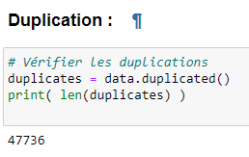
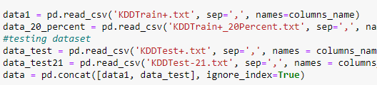
Data Preparation

Slide 17
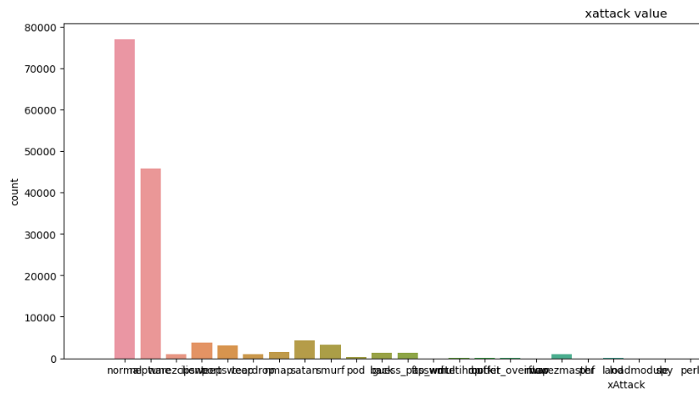
Data Visualization
Notes:
yasmine

Slide 18
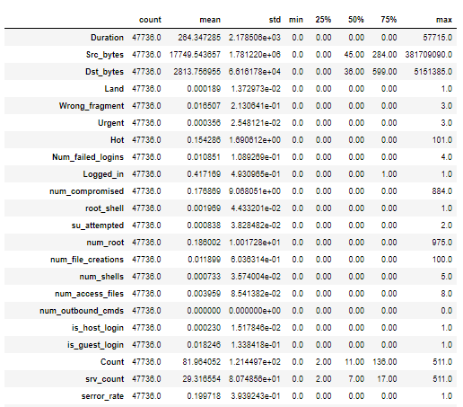
Data Visualization
Notes:
yasmine

Slide 19
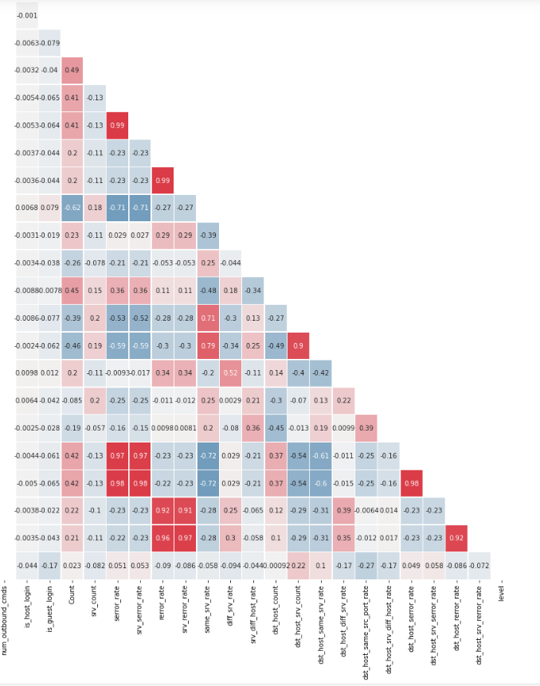
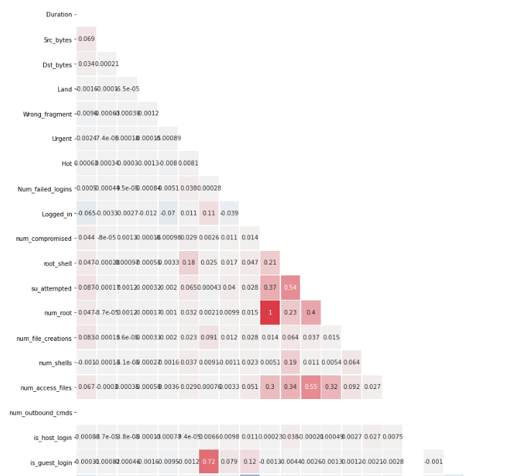
Correlation
Notes:
yasmine

Slide 20
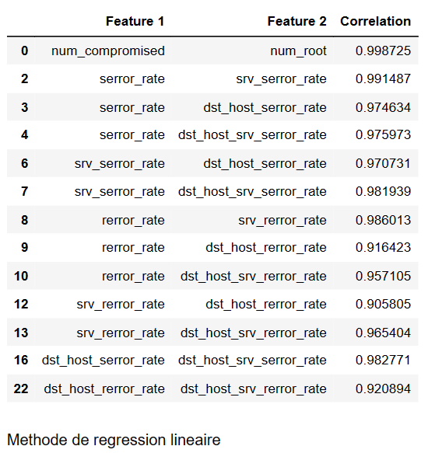
Correlation
Notes:
yasmine

Slide 21
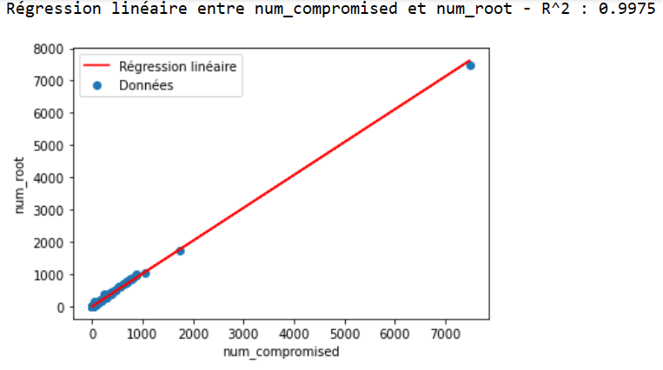
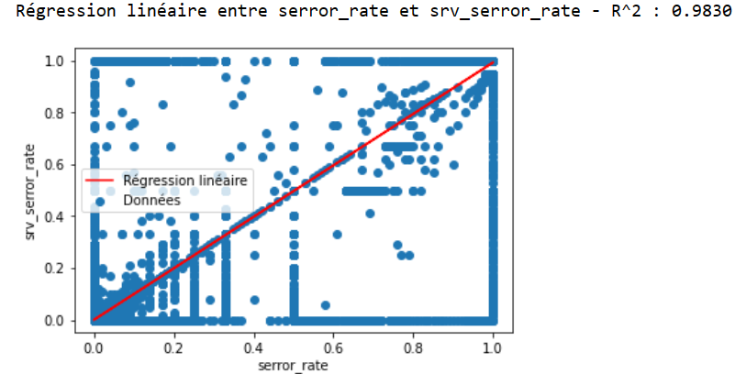
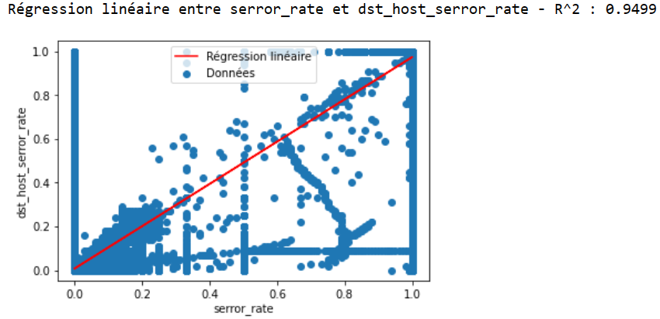
Linear Regression
Notes:
yas

Slide 22
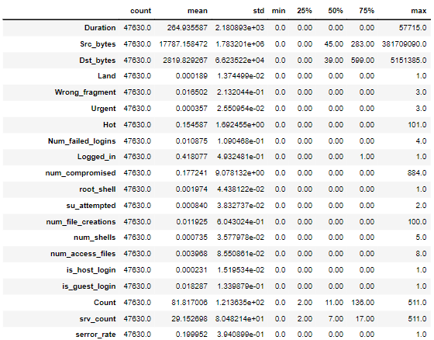
Linear Regression
Notes:
yas

Slide 23
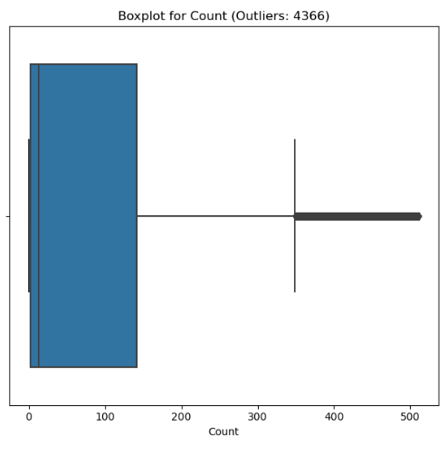
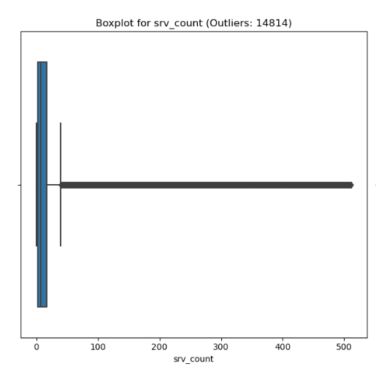
Detecting Outliers
Notes:
Abir : after visualising the description of the dataset and the boxplot we focuses only on the features that have non null observations

Slide 24
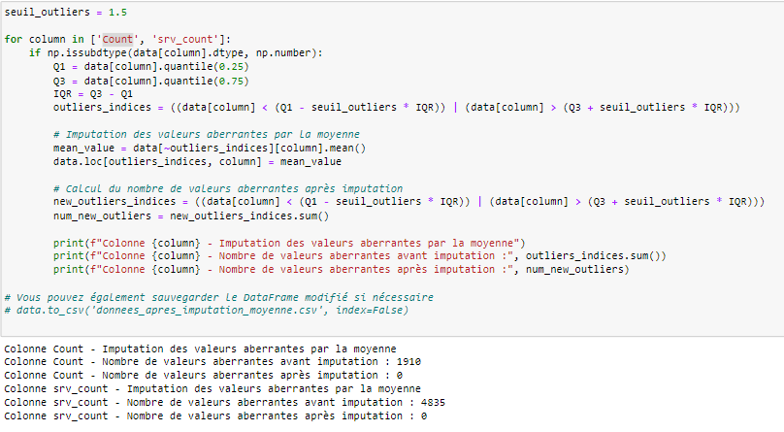
Dealing with Outliers
Notes:
That’s why We decide to deal with the features count and srv count

Slide 25
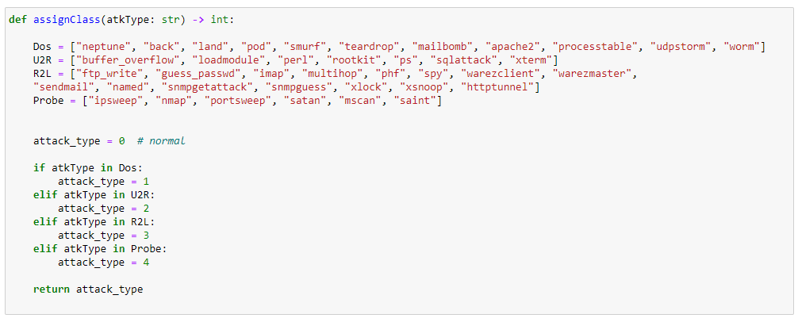
Feature Engineering:
Notes:
abir

Slide 26
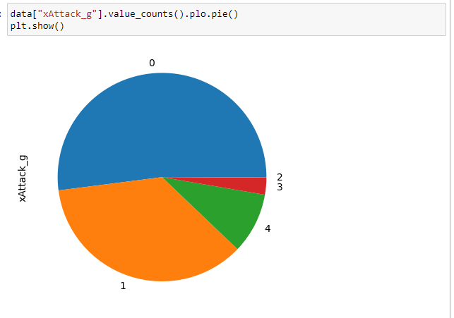
VISUALIZATION

Slide 27
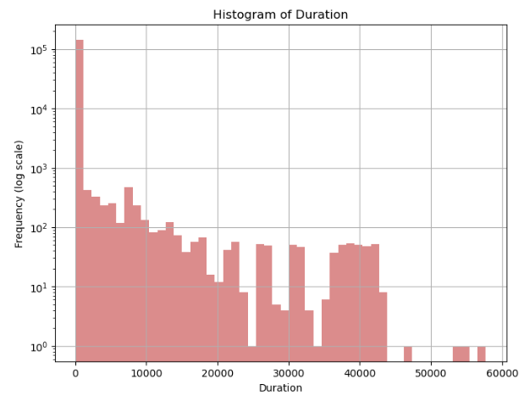
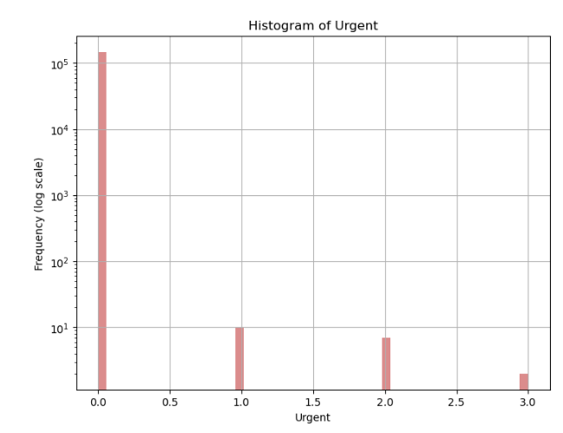
Univariate Analaysis

Slide 28
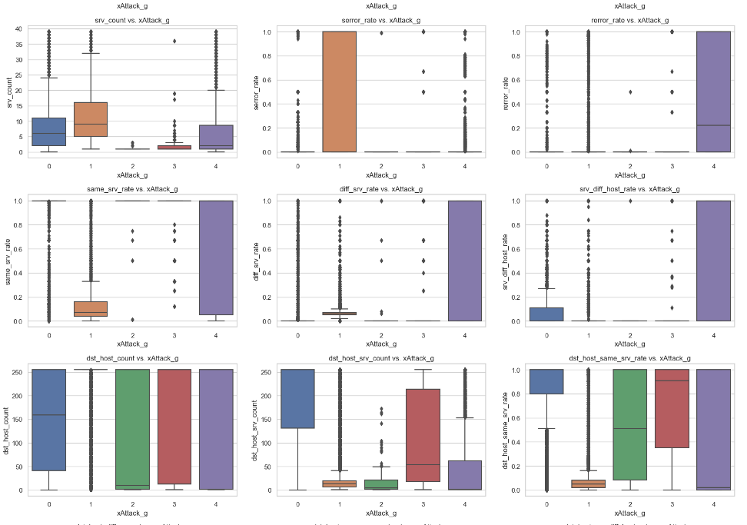
Bivariate Analysis
Notes:
siwar

Slide 29
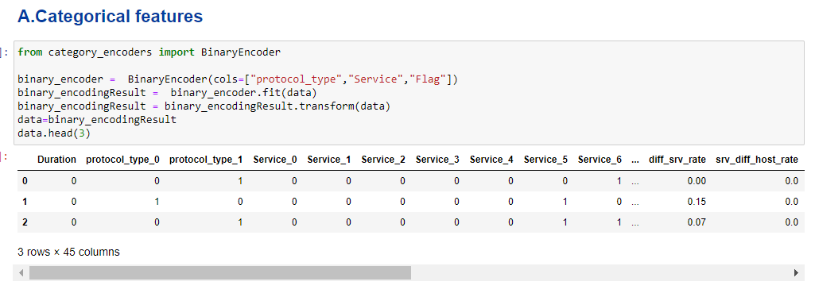
Data transformation
Notes:
jean

Slide 30
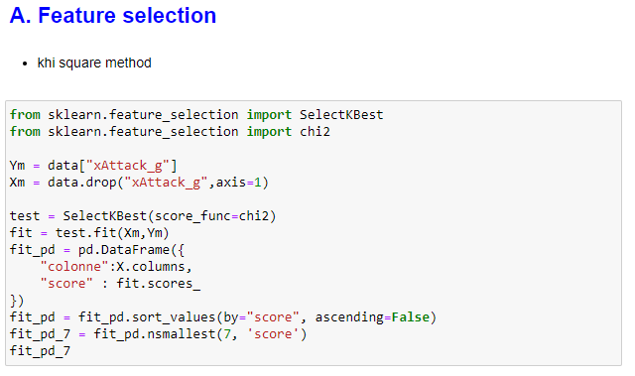
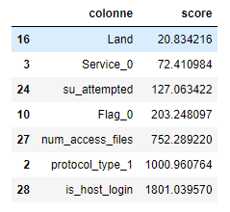
Dimensionality Reduction

Slide 31
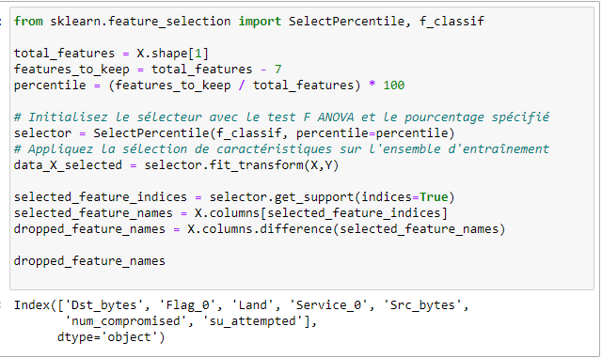
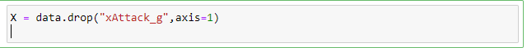
ANOVA
*Selecting the features to delete
*Deleting
Notes:
y

Slide 32
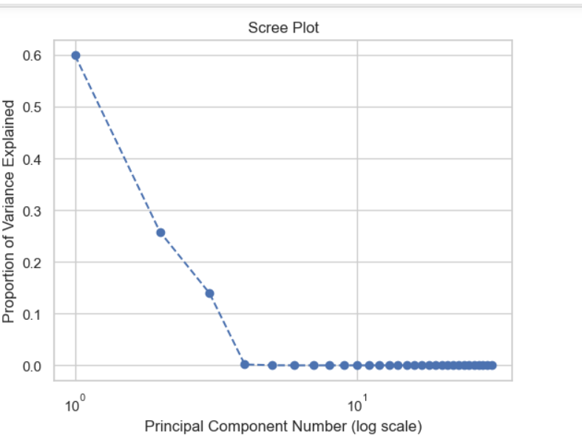
PCA
Notes:
abir

Slide 33
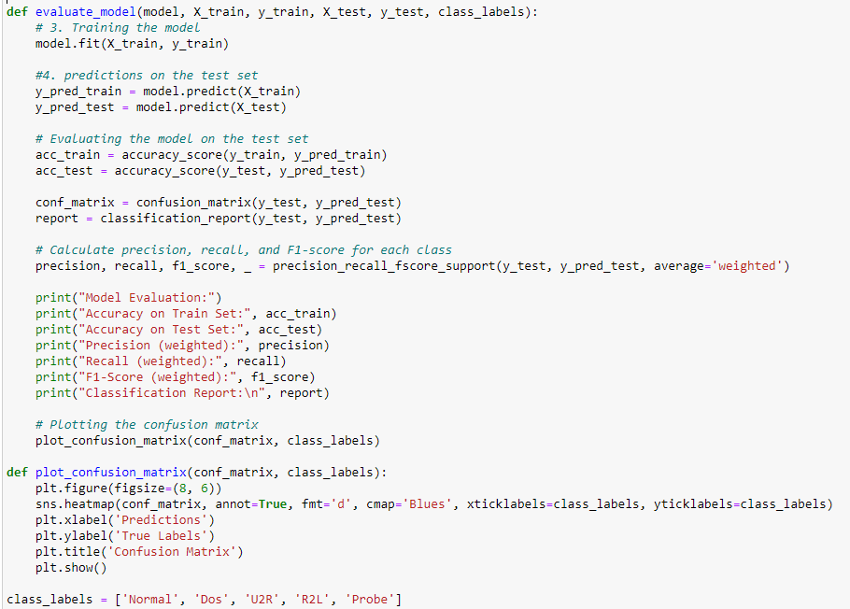
Models function
Notes:
Eya

Slide 34
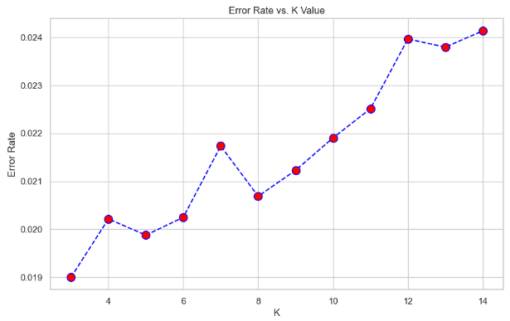
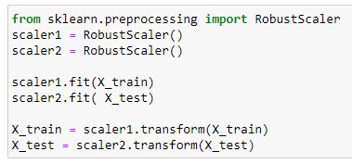
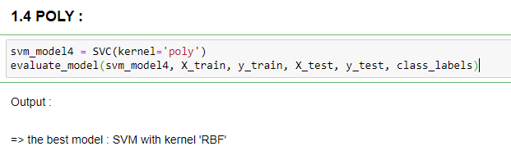
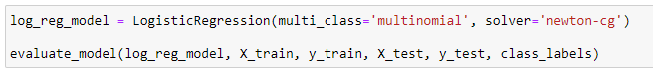
KNN model
Best Hyperparameter
SVM model
Logistic Regression model

Slide 35
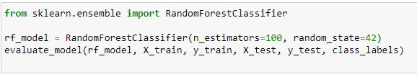
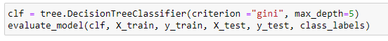
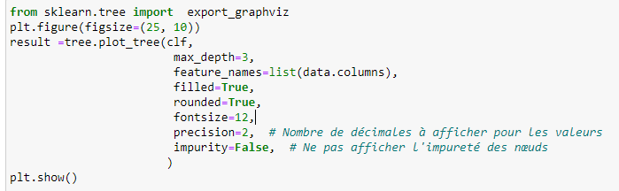
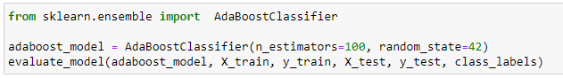
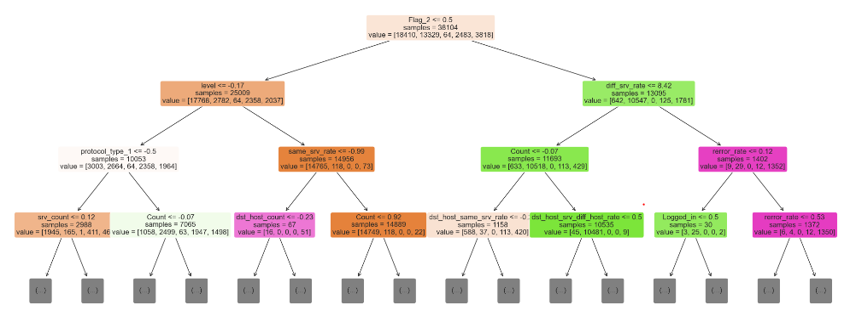
Decision Tree Model
Random Forest Model
AdaBoost Classifier

Slide 36
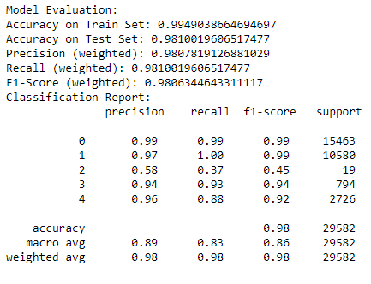
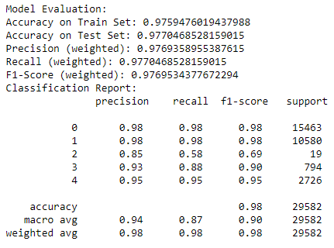
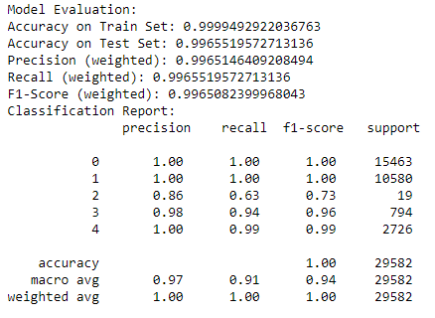
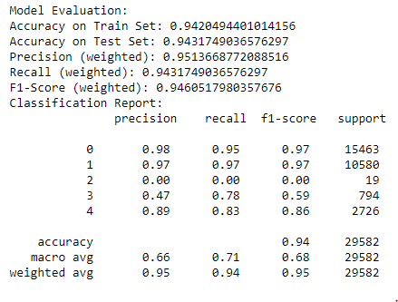
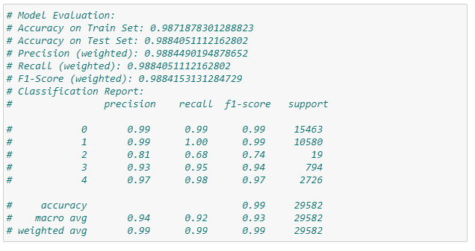
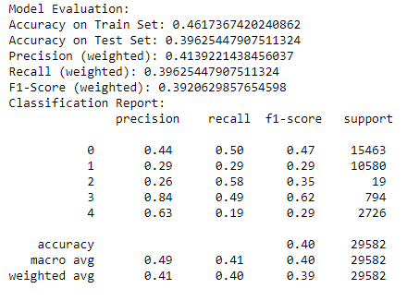
Models Evaluation
Knn
Logistic Regression
Random Forest Model
Boosting : AdaBoost Classifier
Decision Tree
SVM MODEL :

Slide 37
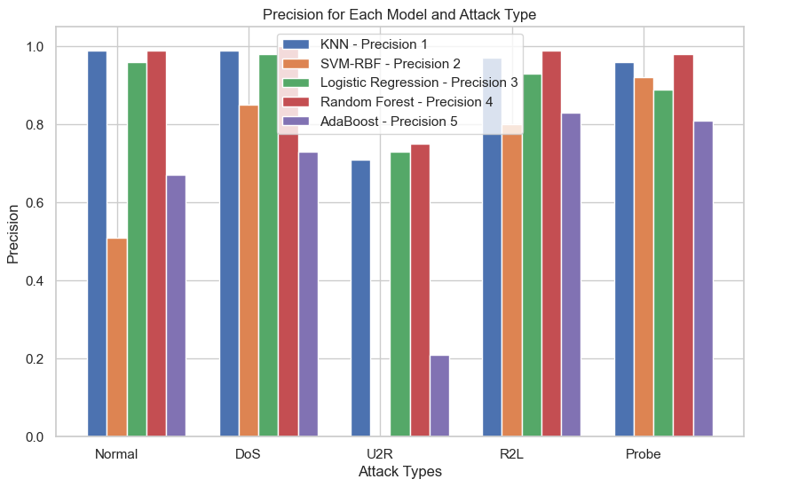
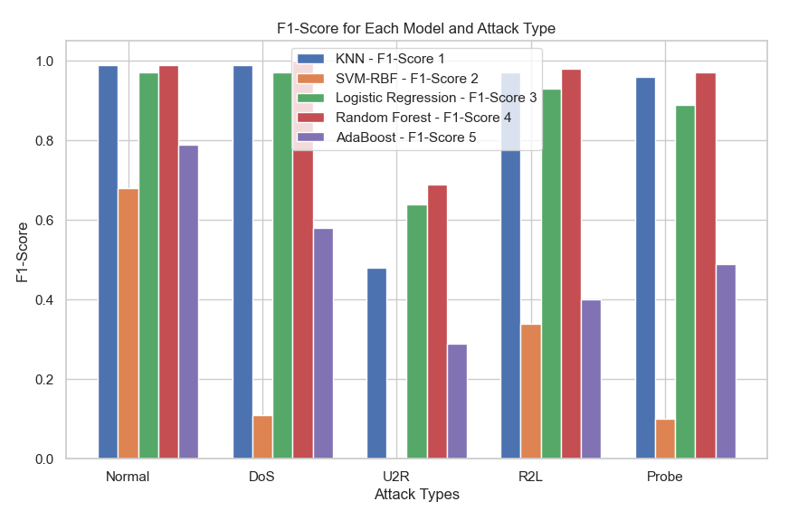
Models comparaison
Recall
Precision
F1-Score
Best Result with Random Forest

Slide 38
03
Anomaly Detection Using Gaussian Mixture Probability Model to Implement Intrusion Detection System

Slide 39
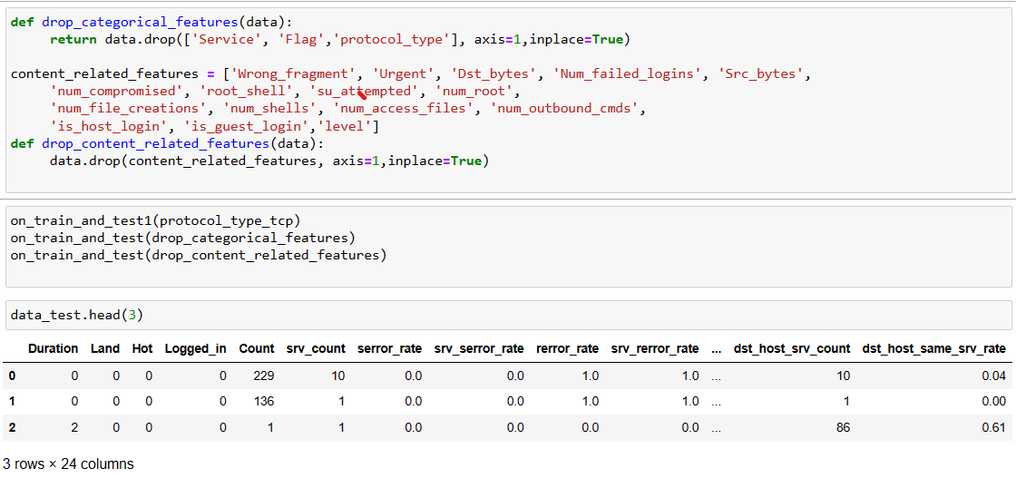
Pre-processing
Notes:
Eya

Slide 40
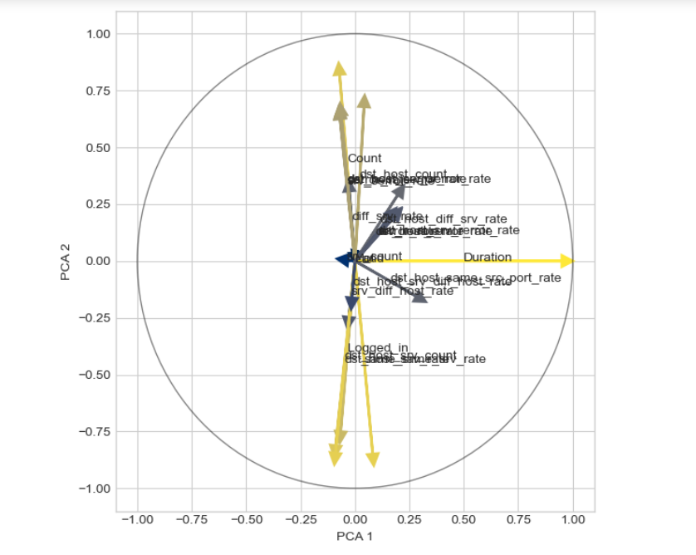
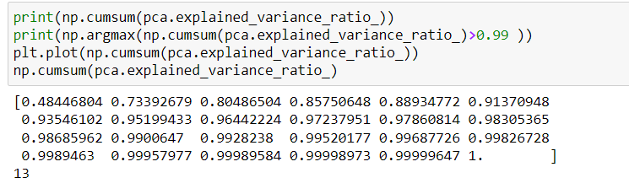
Circle Correlation
Notes:
yas

Slide 41

FGMPM

Slide 42

Create DataSets

Slide 43
Models

Slide 44


GMM Voting _ GMM Classic

Slide 45

GMM Voting Confusion matrix

Slide 46



Projection de PCA sur GMM

Slide 47


K_means

Slide 48

K_means:
squared euclidean
distances

Slide 49



Hyper parameter
*Find the best hyper parameter using standard deviation method

Slide 50

DBSCAN

Slide 51


Evaluation

Slide 52
04
Déploiement

Slide 53


Slide 54


Slide 55
Thank you

